Slide 1
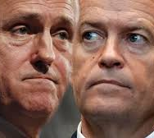

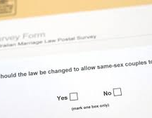
Trend analysis on 2016 Federal Election and 2017 Australian Marriage Law Postal Survey results
Catherine Sloan, Danielle Cahill, Anne Wieggers
Monash University
April 2021

Slide 2

Agenda
Theme and purpose
Project overview
Data sources
Extract, Transform and Load
Coding approach
Snapshots code, raw data and visualisations
Demonstration and observations
Enhancements and challenges
Questions

Slide 3
Trend analysis of Federal Election and Marriage Law Postal Survey results
2016: Federal Elections
2017: Australian Marriage Postal Survey: “Should the law be changed to allow same-sex couples to marry?”
Theme: How is the outcome of the federal elections in 2016 reflected in the outcome of the Australian Marriage Law Postal Survey (“MPS”)? Is there a relationship between these outcomes and socio-economic factors such as age and education?
Purpose: This analysis can provide valuable insights for political parties and campaign organisers for future federal elections and surveys when running their campaigns
The following relationships can be analysed:
Do highly educated people tend to vote for same-sex marriage?
Do young(er) people tend to vote for same-sex marriage?
Is there a relationship between the above and elected party within the states and electorates?

Slide 4
Project overview
ETL Project
Extract, transform and load data related to the federal elections held in Australia 2016 and the MPS held in 2017.
The ETL project generated a database that can be used for trend analysis on federal election and MPS results in states/electoral divisions
Set up a Flask app that creates routes to underlying data in the created database
Create visualisations – upon selection of a state in the dropdown menu:
The bar chart will reflect the MPS respondents classified by age
The pie chart will reflect the percentage of votes for a change in law (“yes votes”)
The bubble chart will reflect the % of yes votes, the % of votes for the Labor Party and the % of population that with a higher education
The map will reflect the electorates within each state, the elected political party, the % of yes votes and the participation rate in the MPS

Slide 5
Data sources
Australian Electoral Commission: 2016 Federal Election Vote Types by Division
Australian Electoral Commission: 2016 Federal Election Results
Kaggle: Australian Marriage Law Postal Survey Electorate Results
Kaggle: Australian Marriage Law Postal Survey Participant Information
Australian Bureau of Statistics: Commonwealth Electorate Data

Slide 6
Extract, Transform and Load
Step | What | How
Extract | Extracting data from source | Web scraping and document downloads
Transform | Check and convert datatypes | Pandas
 | Remove NaN values and duplicates
 | Drop irrelevant columns and rename columns
 | Set primary key as index
 | Merge tables (joining on primary key)
 | Perform “group by” functions and aggregates to run calculations
 | Recreate bins so that all age bins used within all tables are consistent
Exploratory data analysis | Summary statistics and visualisations | Pandas, Matplotlib
Load | Create database structure and load data | PostgreSQL, PgAdmin, Pandas

Slide 7
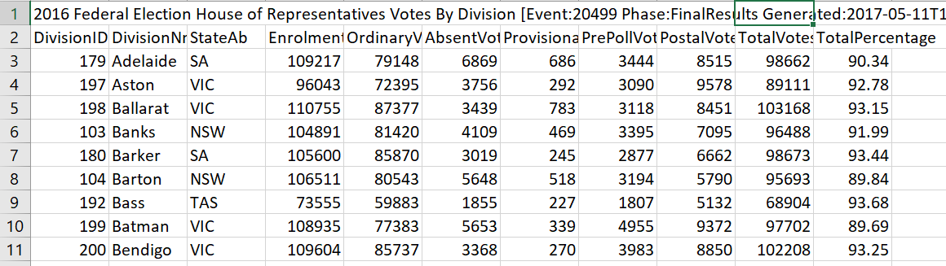
Snapshots raw data
Federal Elections

Slide 8
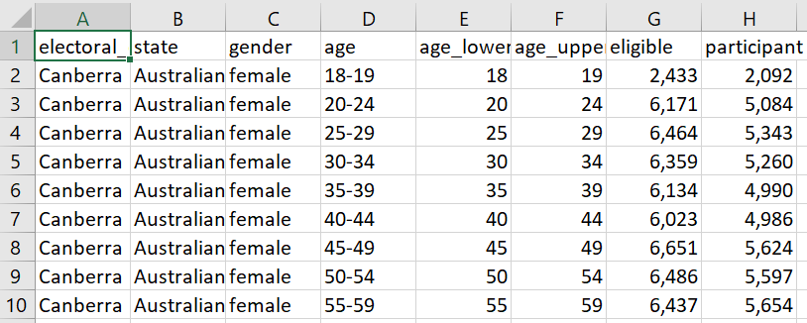
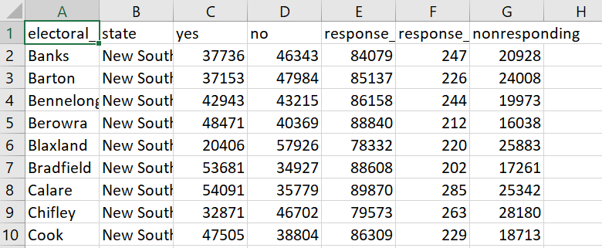
Snapshots raw data
Australian Marriage Postal Survey

Slide 9
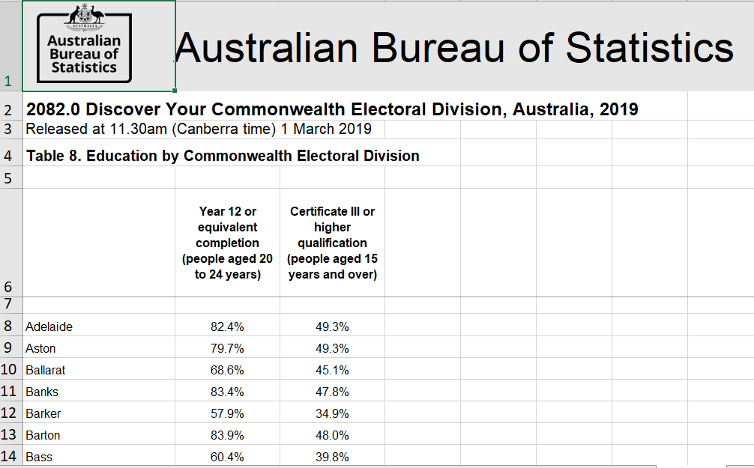
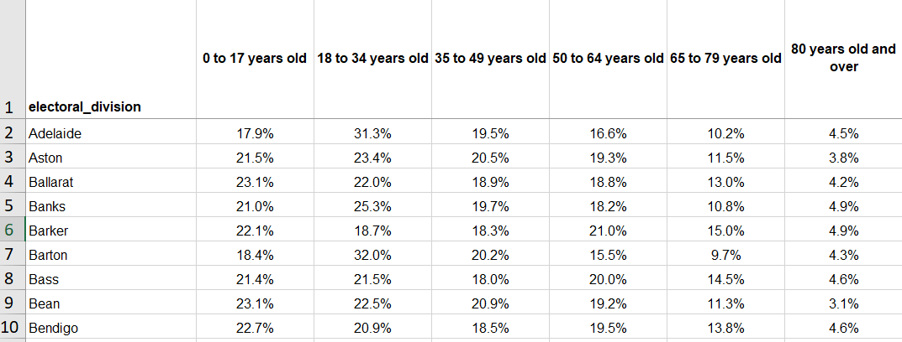
Snapshots raw data
Commonwealth electorate data

Slide 10
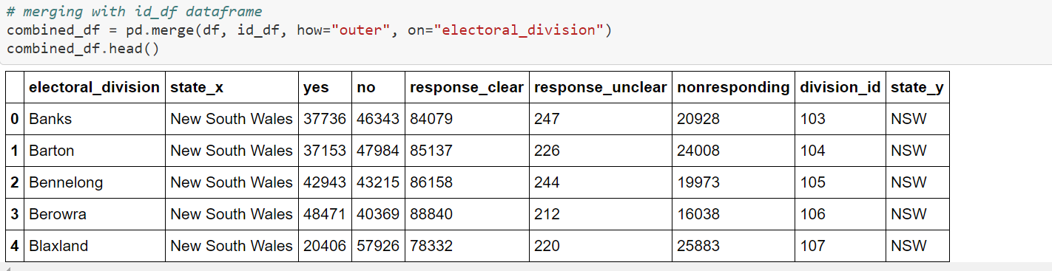
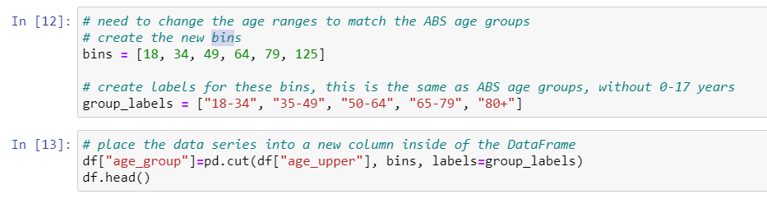
Snapshots ETL code
Merging dataframes
Creating bins

Slide 11
Coding approach
Step | What | How
Flask app | Import modules | OS Pandas Numpy SQLAlchemy Flask SimpleJson
 | Connect to and reflect database tables
 | Create session link
 | Conversion of results to JSON
 | Creating routes for rendering index.html, tables and visualisations

Slide 12
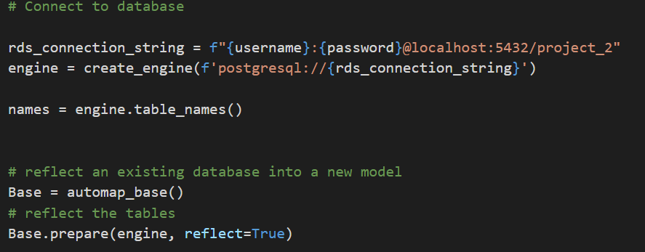
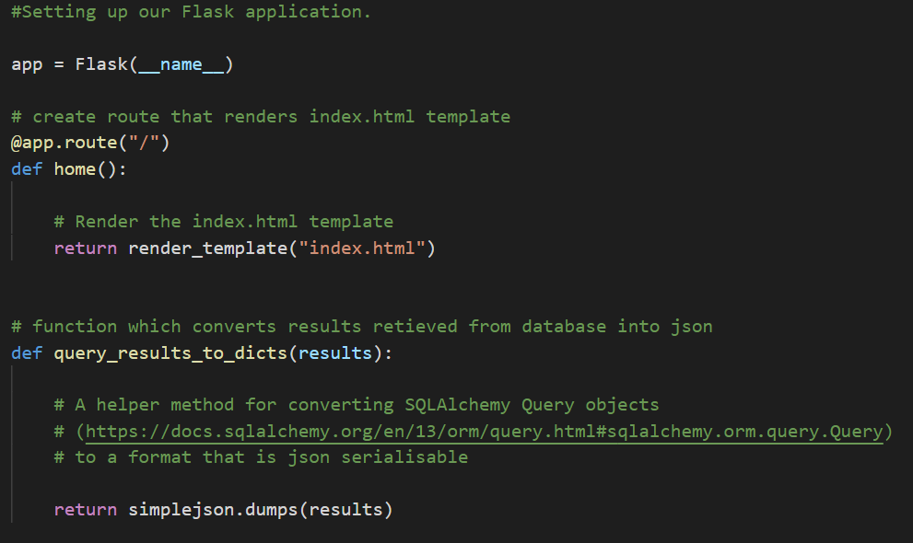
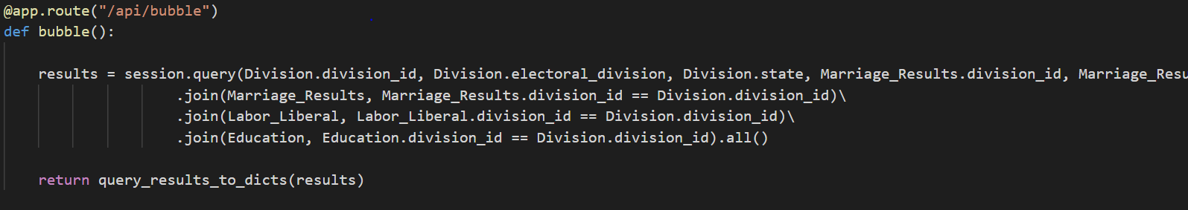
Snapshots Flask app
Flask app and routes

Slide 13
Coding approach
Step | What | How
Visualisations | Dropdown menu | D3 Javascript CSS Leaflet Chloropleth Bootstrap GeoJSON
 | Pie chart
 | Bar chart
 | Bubble chart
 | Map

Slide 14
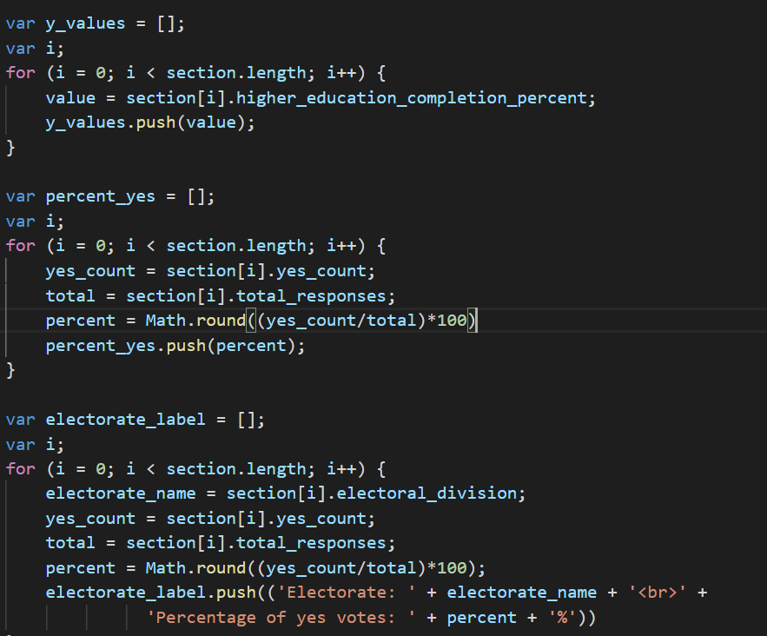
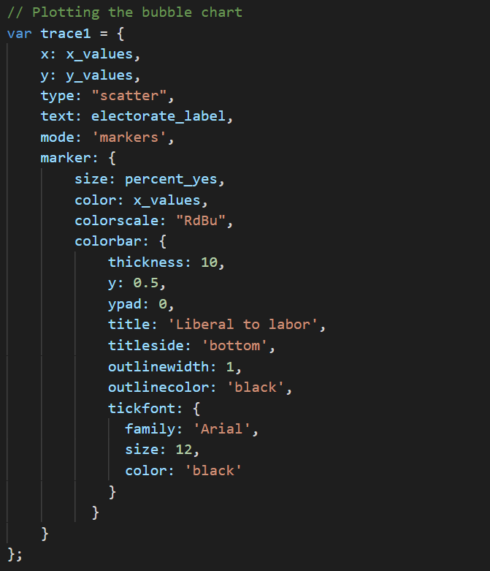
Snapshots code visualisations
Bubble chart, pie chart and bar chart

Slide 15
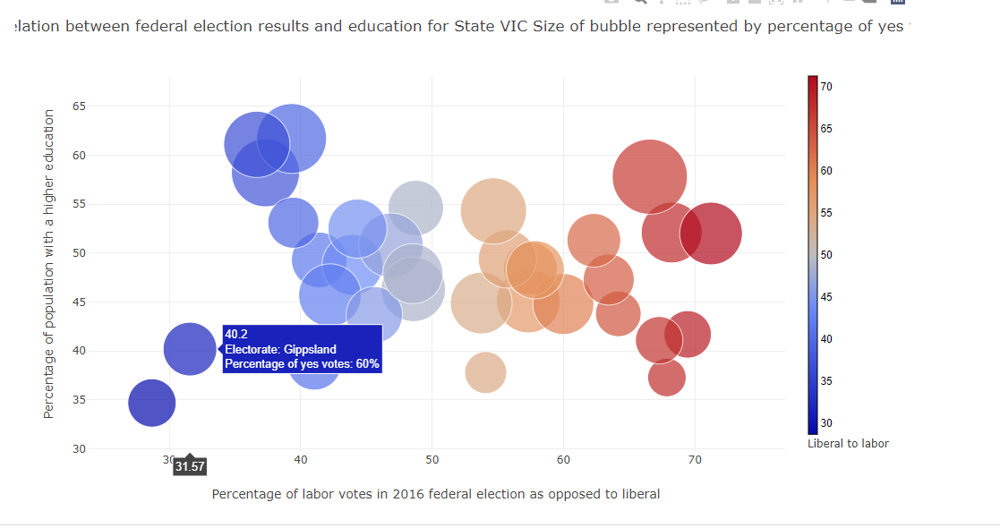
Snapshots visualisations

Slide 16
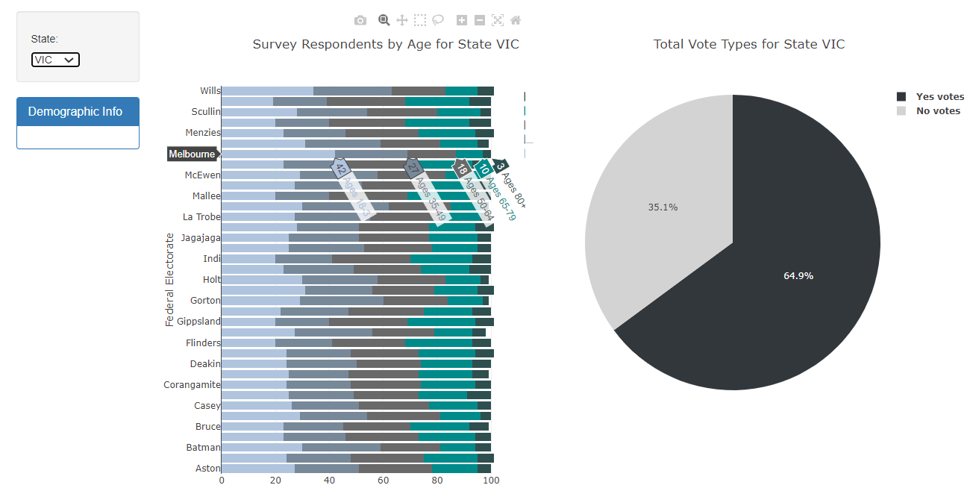
Snapshots visualisations

Slide 17
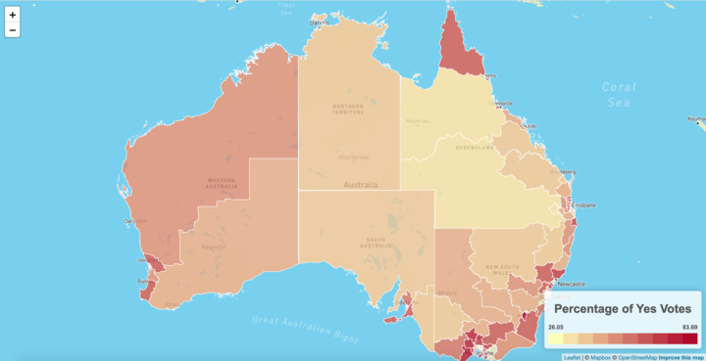
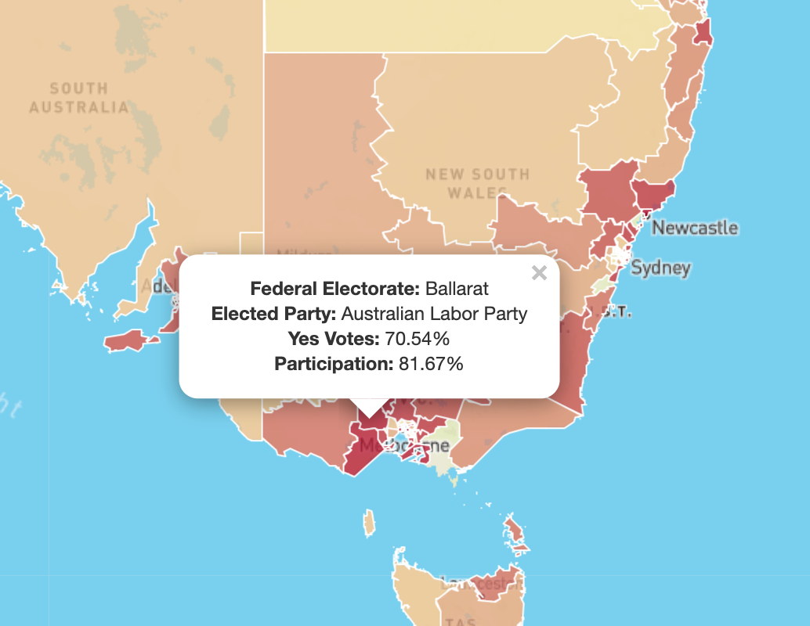
Snapshots visualisations

Slide 18
Demonstration and observations
For states with a very few electorates, it can be easily observed whether electorates with a higher % of education tend to vote Liberal or Labor, and whether these this depends on the amount of elderly people or younger people.
This does not seem to be consistent across states (compare NT/ACT vs. TAS)
TAS: majority elderly people and most electorates vote Liberal and are less highly educated.
NT/ACT: majority elderly people and most electorates with people voting Labor are less highly educated that people voting Liberal
The map shows the elected party within each electorate, as well as the yes votes and participation rate.
This allows politicians and campaign runners to target their campaigns to specific electorates based on
voting preferences
participation rate
people in specific age categories or with a specific level of education

Slide 19
Challenges and improvements
Challenges | Improvements
As the dataset did not contain the coordinates of the electorates, the outlining of each of the electorates had to be created using GeoJSON. | No colour was shown for certain electorates in the map as some data was missing in part of the data sources
Opening the app on Australia (and not on state level)
Various data sources have slightly different names for certain electorates which resulted in a mismatch in number of data entry points

Slide 20
Questions

